Slide 1
Intro to Computer Vision & NLP
Eng- Mohamed Khaled Idris
Eng- mayar swilam

Slide 2
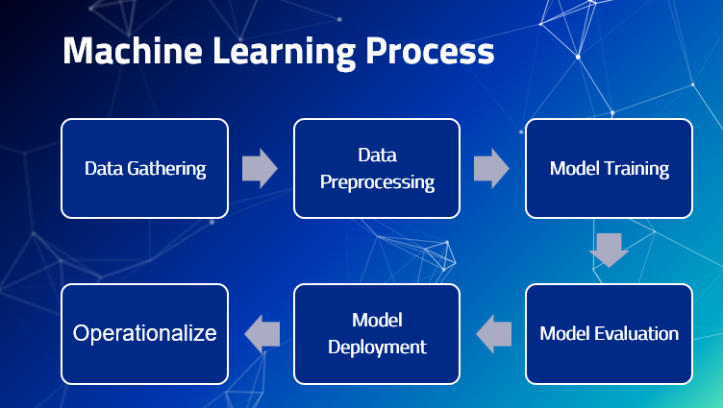

Slide 3
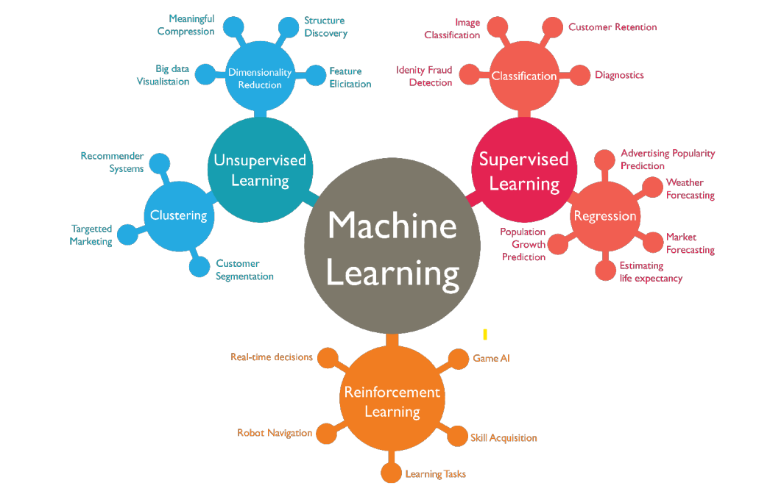

Slide 4

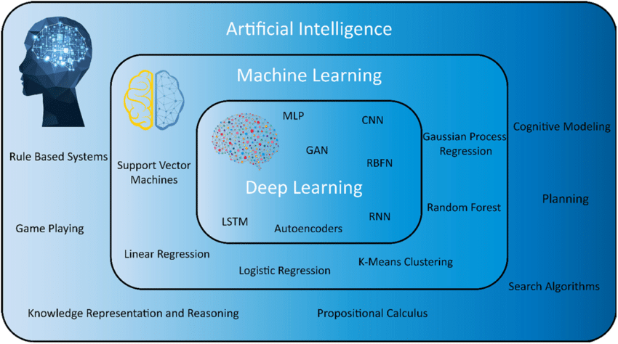

Slide 5
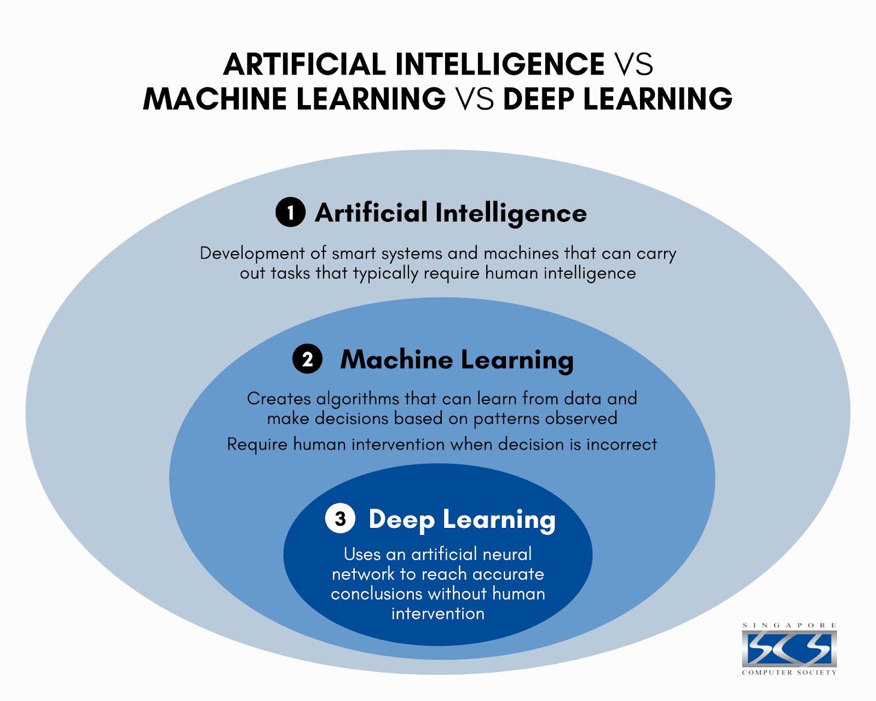

Slide 6
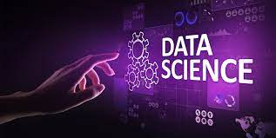
Data science and its History
The term "Data Science" originated in the early 1960s to address the challenges of interpreting and understanding the increasing volumes of data being generated. Initially focused on supporting various fields with statistical methods, Data Science has evolved over the years to incorporate computer science, artificial intelligence, machine learning, and the Internet of Things. Statistics remains a fundamental aspect of Data Science.

Slide 7
Data science and its History
Early Years (1960s-1980s):
  The foundations of data science can be traced back to statistics and computer science. Statisticians have long been involved in analyzing data to draw conclusions and make predictions.
  During the 1960s and 1970s, the advent of computers and the growth of databases led to the development of techniques for managing and processing large datasets.
The Rise of Big Data (1990s-2000s):
  The term "data science" began to gain prominence in the late 1990s. However, it wasn't until the early 2000s that the concept started to crystallize.
  With the explosion of the internet, e-commerce, and social media, vast amounts of data became available, giving rise to the era of big data. Companies and researchers started grappling with the challenges of handling and extracting value from massive datasets.
Technological Advancements:
  Parallel processing, distributed computing, and advancements in storage technologies played a crucial role in enabling the processing of large-scale datasets. Technologies like Hadoop emerged to handle distributed data processing

Slide 8
Data science and its History
5.Emergence of Data Science as a Discipline (2010s):
  As the need for expertise in handling big data grew, organizations began to recognize the importance of professionals who could not only manage data but also analyze it to extract actionable insights.
  Data science became an interdisciplinary field, borrowing concepts from statistics, mathematics, computer science, and domain expertise. The ability to derive insights from complex datasets became a valuable skill.
6. Machine Learning and Artificial Intelligence (AI):
  The integration of machine learning and AI techniques into data science further expanded its capabilities. Predictive modelling, classification, clustering, and other ML techniques became essential tools for data scientists.
7. Data Science in Industry:
  Organizations across various sectors, including finance, healthcare, marketing, and more, started employing data scientists to gain a competitive advantage, improve decision-making, and optimize processes.
8. Ongoing Evolution (2020s and Beyond):
  Data science continues to evolve with advancements in technology, including the growth of cloud computing, the adoption of advanced analytics tools, and the integration of artificial intelligence into various applications.

Slide 9
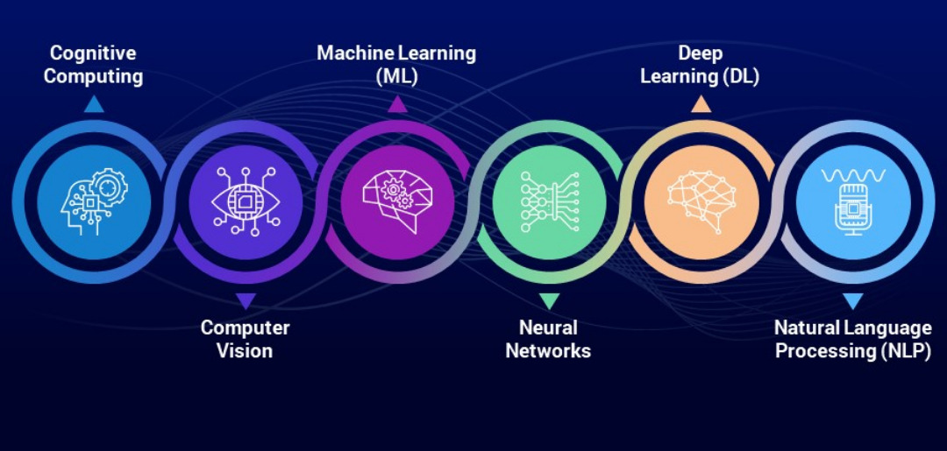

Slide 10
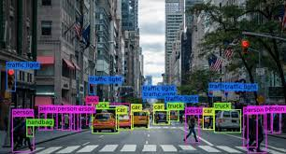
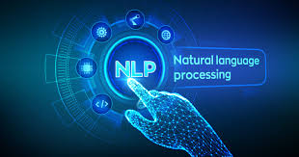
Computer Vision & NLP

Slide 11
Computer Vision
Computer vision is a multidisciplinary field that enables computers to interpret and understand visual information from the world, similar to how humans perceive and interpret visual data. It involves the development of algorithms, models, and systems that allow machines to analyze and make decisions based on images or videos.
Computer vision applications are diverse and can be found in various industries, including healthcare, automotive, agriculture, security, and entertainment.

Slide 12
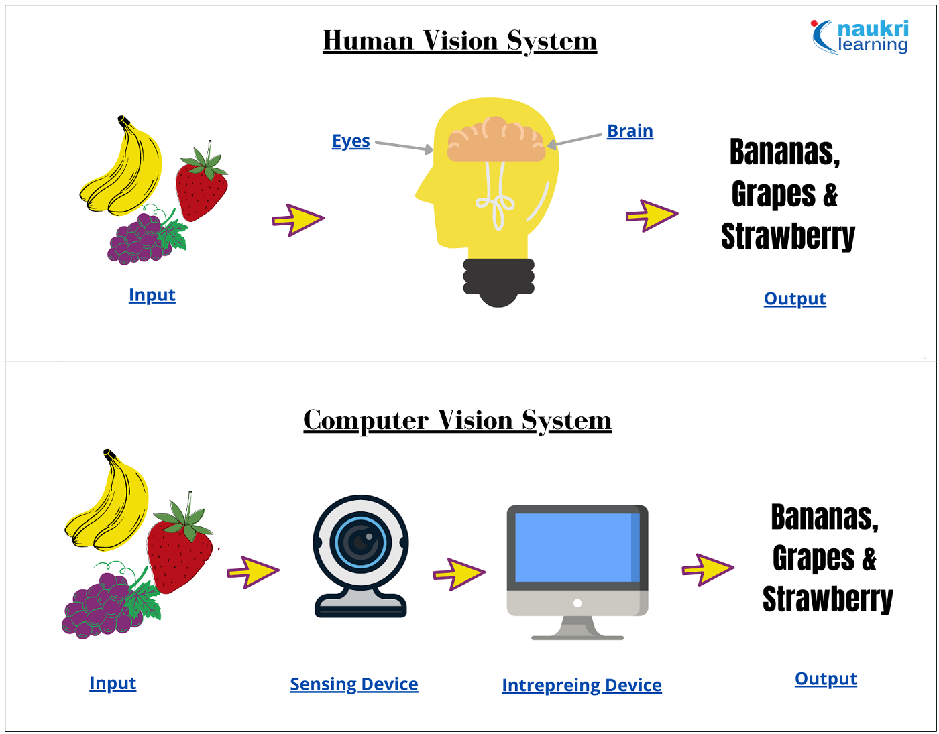

Slide 13
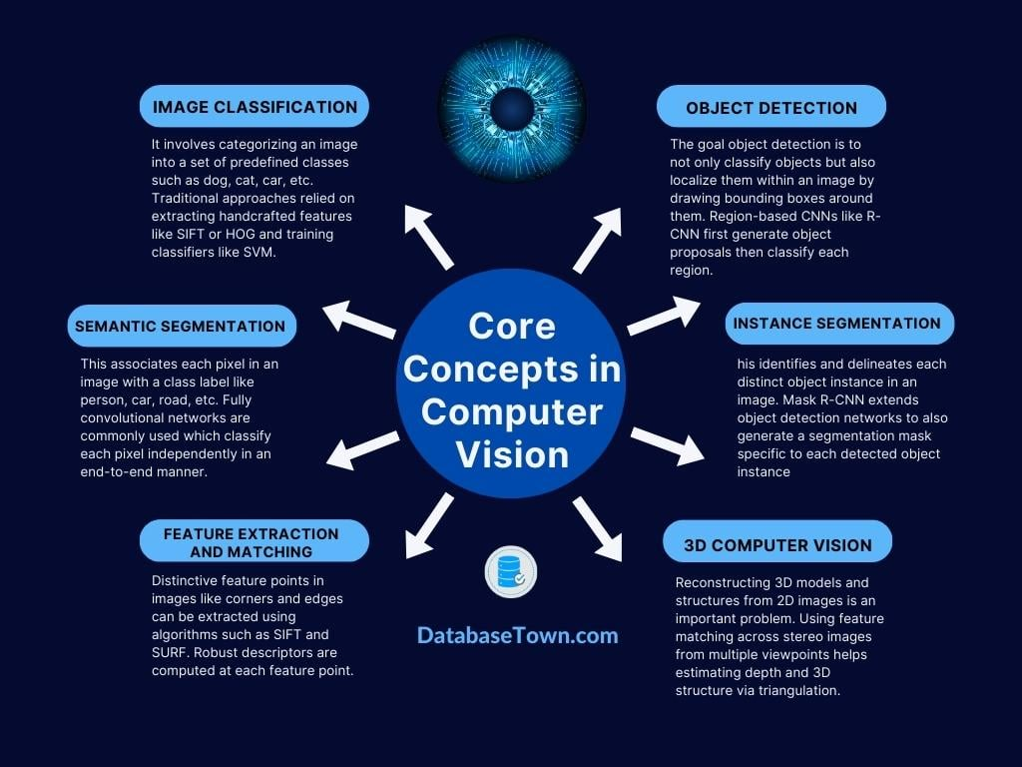

Slide 14
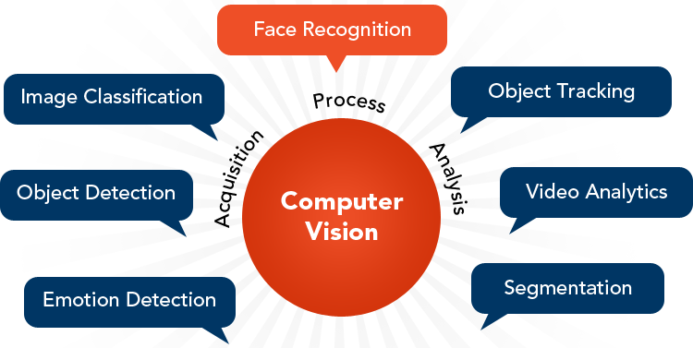
Computer Vision

Slide 15


Slide 16
computer vision libraries
Computer Vision Libraries
OpenCV (Open Source Computer Vision Library):
  OpenCV is a widely-used open-source computer vision library that provides a vast collection of tools and algorithms for image and video processing, feature extraction, object detection, machine learning, and more. It supports multiple programming languages, including Python, C++, and Java.
TensorFlow:
  Developed by Google, TensorFlow is an open-source machine learning library that includes modules for deep learning and neural networks. TensorFlow provides a high-level API called TensorFlow Keras for building and training neural networks, making it suitable for computer vision tasks.
PyTorch:
  PyTorch is an open-source deep learning library developed by Facebook. It has gained popularity for its dynamic computational graph and ease of use. PyTorch is commonly used for research in computer vision and natural language processing. It also provides the torchvision module for computer vision-specific functionalities.

Slide 17
computer vision libraries
Computer Vision Libraries
Keras:
  Keras is a high-level neural networks API written in Python and capable of running on top of TensorFlow, Theano, or Microsoft Cognitive Toolkit (CNTK). While it's often used for general deep learning tasks, it also includes modules for image classification, object detection, and other computer vision applications.
Scikit-Image:
  Scikit-Image is a collection of algorithms for image processing in Python. It builds on the capabilities of NumPy and provides tools for tasks such as filtering, morphology, segmentation, and feature extraction.
Dlib:
  Dlib is a C++ toolkit for machine learning and computer vision. It includes a variety of algorithms for image processing, facial recognition, object detection, and more. Dlib is known for its efficiency and performance.

Slide 18
computer vision libraries
Computer Vision Libraries
MXNet:
  Apache MXNet is an open-source deep learning framework designed for efficiency and scalability. It supports both symbolic and imperative programming and includes GluonCV, a toolkit for computer vision tasks built on top of MXNet.
Caffe:
  Caffe is a deep learning framework developed by the Berkeley Vision and Learning Center. It is popular for its speed and efficiency in convolutional neural networks. While it's not as flexible as some other frameworks, it excels in image classification tasks.
Fastai:
  Fastai is a high-level deep learning library built on top of PyTorch. It aims to make deep learning more accessible through high-level abstractions and simplifications. Fastai includes modules for computer vision, natural language processing, and tabular data.
MATLAB Computer Vision Toolbox:
  MATLAB provides a Computer Vision Toolbox that offers a comprehensive set of functions for image and video processing, computer vision, and machine learning. It is widely used in academic and research environments.

Slide 19
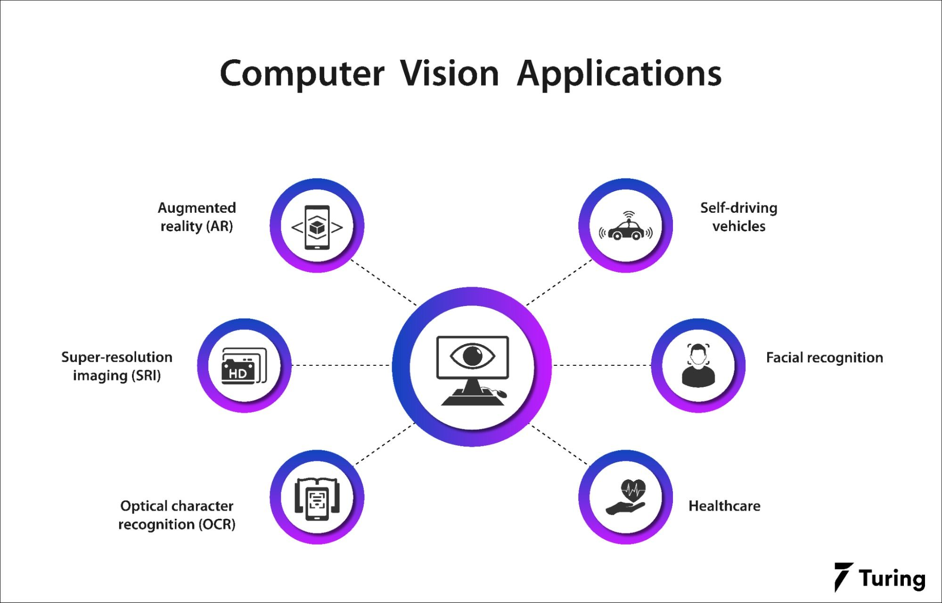

Slide 20
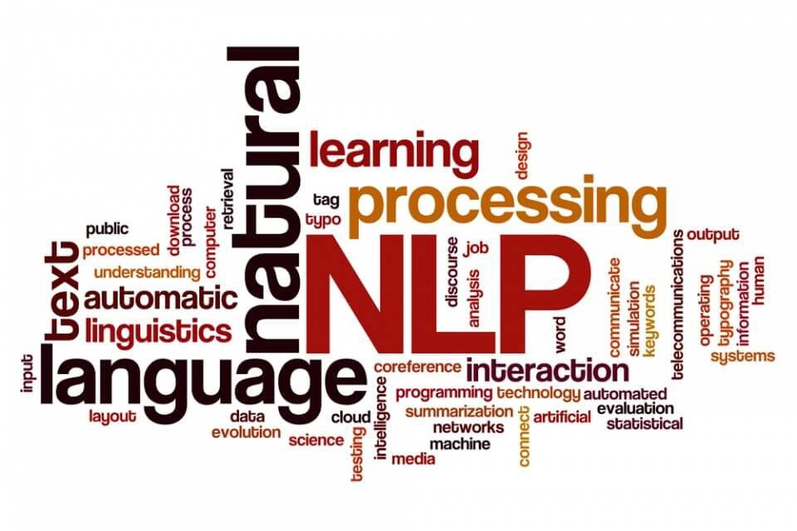

Slide 21
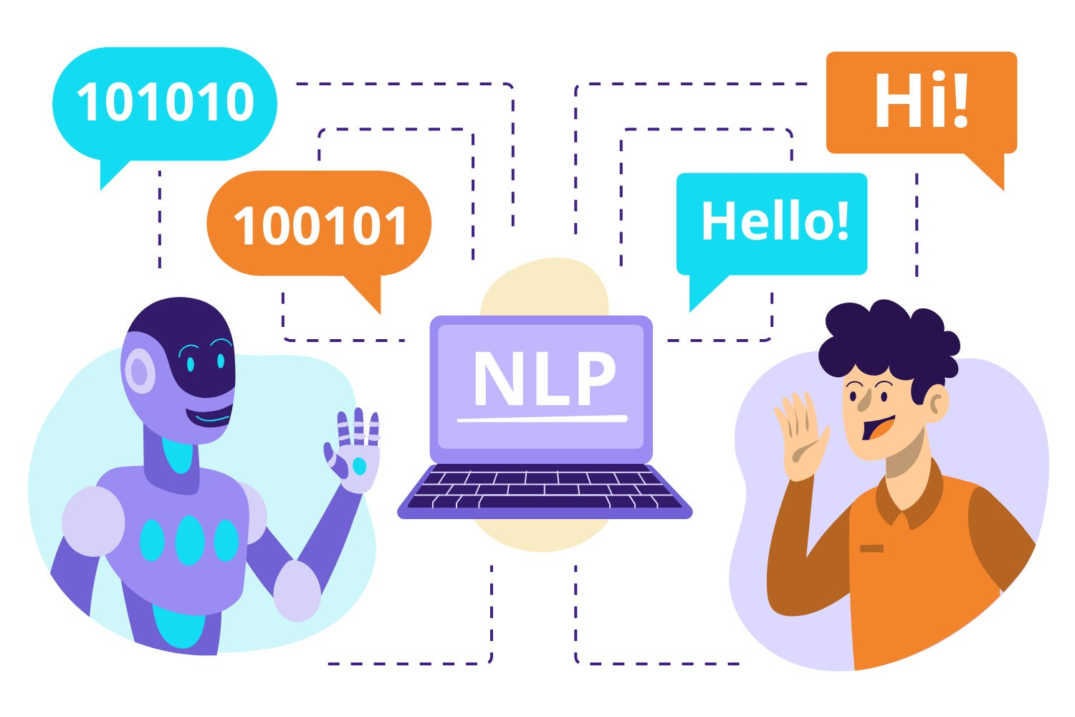
computer vision libraries
Natural language processing (NLP)

Slide 22
computer vision libraries
Natural language processing (NLP)
Natural Language Processing (NLP) is a subfield of artificial intelligence (AI) that focuses on the interaction between computers and human language. The goal of NLP is to enable computers to understand, interpret, and generate human language in a way that is both meaningful and contextually relevant. It involves the development of algorithms and models that allow computers to perform tasks such as text and speech recognition, language translation, sentiment analysis, and more.

Slide 23
computer vision libraries
Natural language processing Algorithms
Tokenization:
  Algorithm: Basic tokenization involves breaking down a text into individual words or tokens.
  Example: Splitting the sentence "The quick brown fox jumps over the lazy dog" into individual words: ["The", "quick", "brown", "fox", "jumps", "over", "the", "lazy", "dog"].
Part-of-Speech Tagging (POS):
  Algorithm: Assigning grammatical parts of speech (e.g., noun, verb, adjective) to each word in a sentence.
  Example: Tagging the sentence "The cat is sleeping" with parts of speech: [("The", "Determiner"), ("cat", "Noun"), ("is", "Verb"), ("sleeping", "Verb")].
Named Entity Recognition (NER):
  Algorithm: Identifying and classifying entities (e.g., names of people, organizations, locations) in a text.
  Example: Extracting entities from the sentence "Apple Inc. is headquartered in Cupertino, California": [("Apple Inc.", "Organization"), ("Cupertino, California", "Location")].

Slide 24
computer vision libraries
Natural language processing Algorithms
Text Classification:
  Algorithm: Assigning predefined categories or labels to a document or text.
  Example: Classifying emails as spam or non-spam based on their content.
Word Embeddings:
  Algorithm: Learning vector representations (embeddings) for words in a way that captures semantic relationships.
  Example: Word2Vec, GloVe, and FastText are popular word embedding algorithms.
Sequence-to-Sequence Models:
  Algorithm: Transforming input sequences into output sequences, often used in machine translation and summarization.
  Example: Recurrent Neural Networks (RNNs) and Transformer models like GPT and BERT.

Slide 25
computer vision libraries
Natural language processing Algorithms
Sentiment Analysis:
  Algorithm: Determining the sentiment or emotion expressed in a piece of text.
  Example: Classifying product reviews as positive, negative, or neutral.
Dependency Parsing:
  Algorithm: Analyzing the grammatical structure of sentences to determine the relationships between words.
  Example: Representing the syntactic structure of a sentence using a dependency tree.
Machine Translation:
  Algorithm: Automatically translating text from one language to another.
  Example: Using statistical models or neural machine translation models like Transformer architectures.

Slide 26
computer vision libraries
Example: English to French Translation
Step 1: Data Preparation
Let's consider a small dataset of English and French sentence pairs:
English: "I love natural language processing."
French: "J'adore le traitement du langage naturel."
Step 2: Tokenization
Tokenize the input (English) and output (French) sentences into individual words:
English: ["I", "love", "natural", "language", "processing"]
French: ["J'adore", "le", "traitement", "du", "langage", "naturel"]
Step 3: Vocabulary
Create separate vocabularies for English and French:
English Vocabulary: ["I", "love", "natural", "language", "processing"]
French Vocabulary: ["J'adore", "le", "traitement", "du", "langage", "naturel"]

Slide 27
computer vision libraries
Example: English to French Translation
Step 4: Assigning Indices
Assign indices to each word in the vocabularies:
English Indices: [0, 1, 2, 3, 4]
French Indices: [5, 6, 7, 8, 9, 10]
Step 5: RNN Model
Train an RNN model to learn the mapping between English and French sequences. The RNN processes one word at a time, maintaining a hidden state that captures the context of the input sequence.
Step 6: Translation
Now, given a new English sentence, the trained RNN can generate a sequence of French words as output.
Input (English): "I enjoy deep learning."
Output (French): "J'apprécie l'apprentissage profond."
In this example, the RNN has learned the patterns and relationships between English and French words during training and is able to generate reasonable translations for new input sequences.

Slide 28
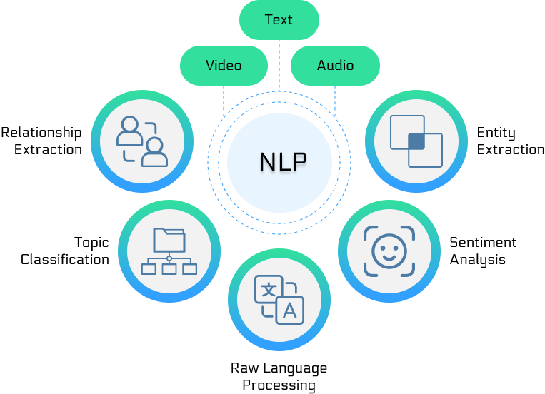

Slide 29
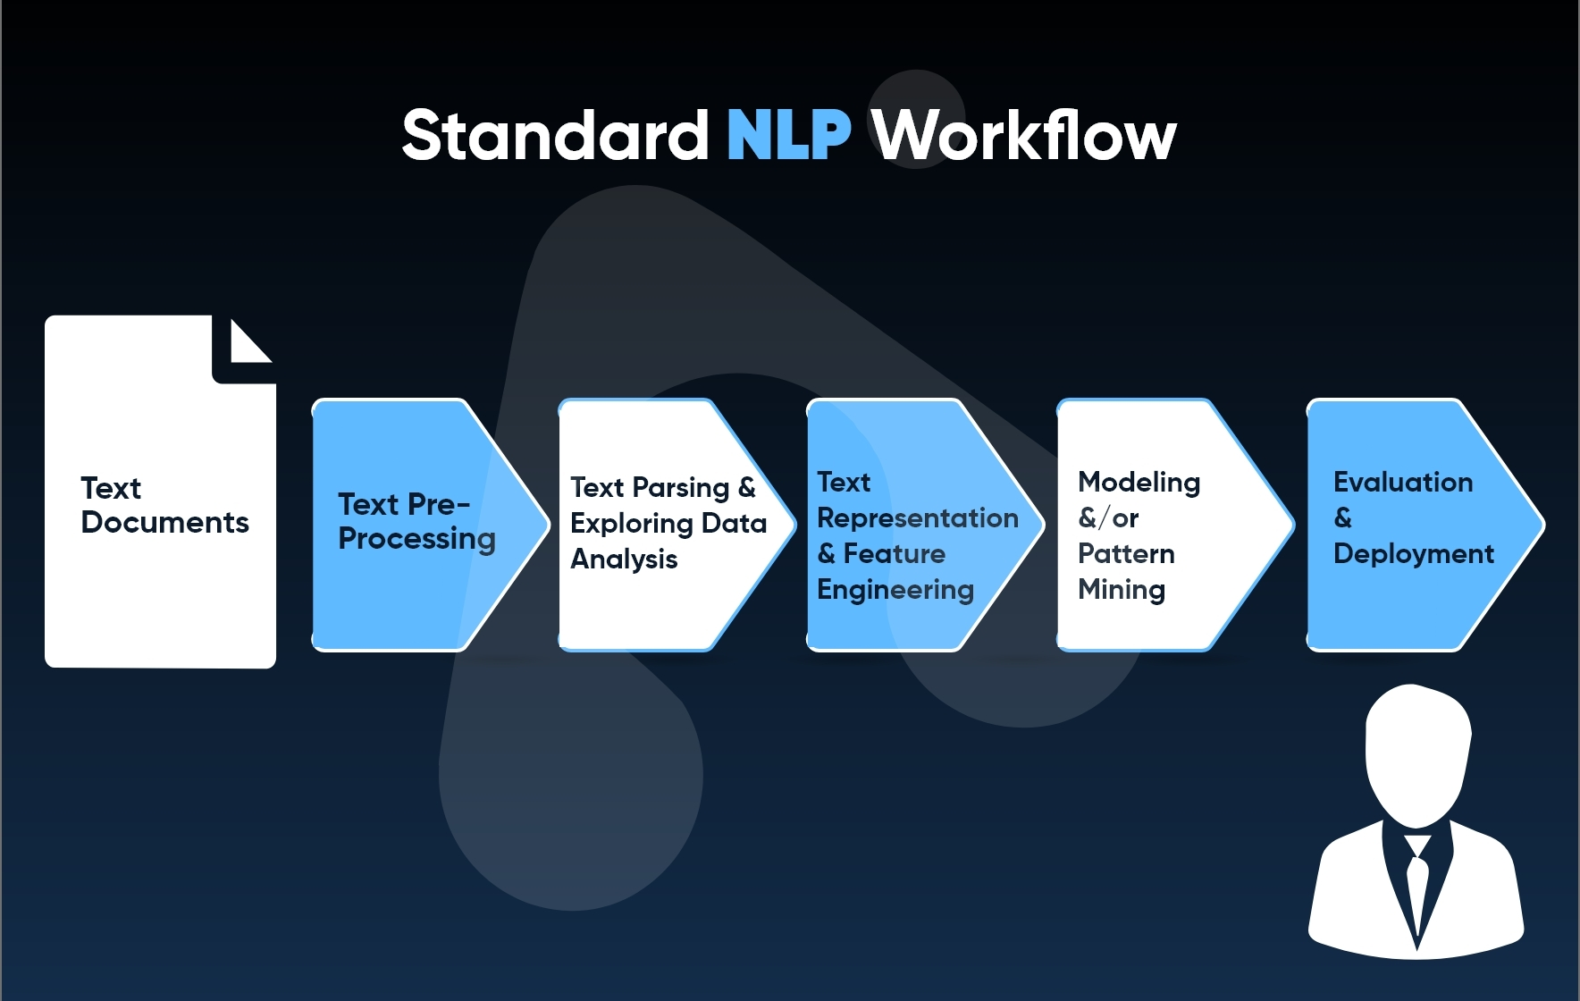
computer vision libraries

Slide 30
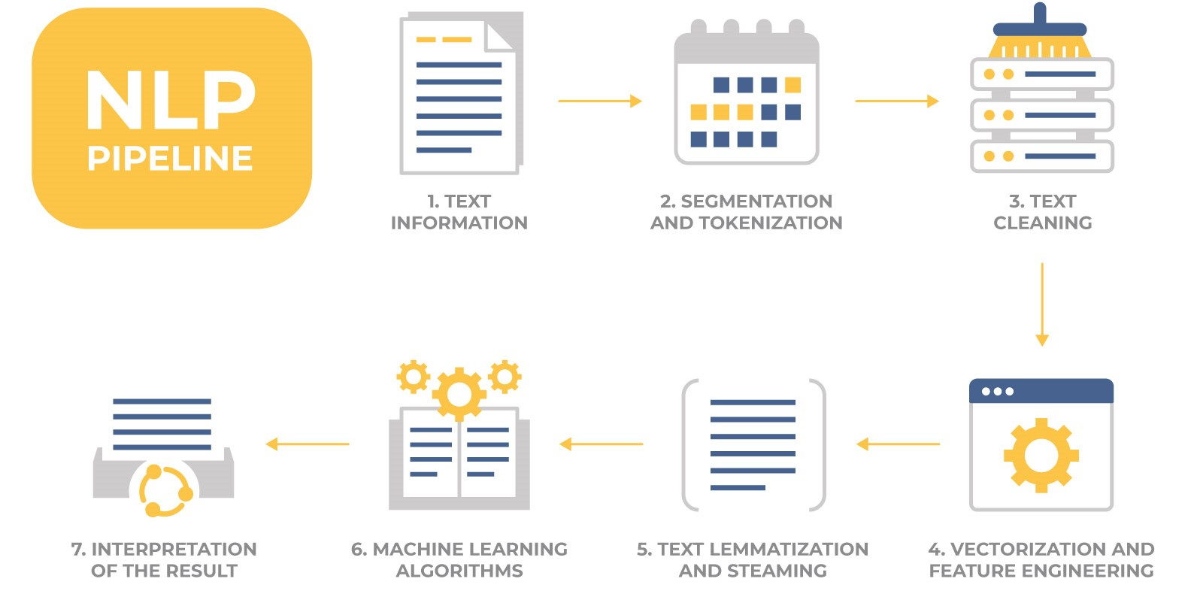
computer vision libraries

Slide 31
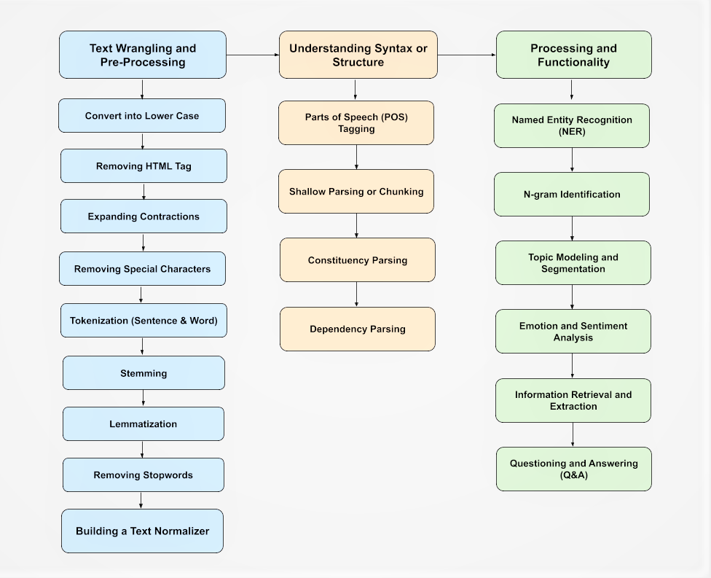
computer vision libraries

Slide 32
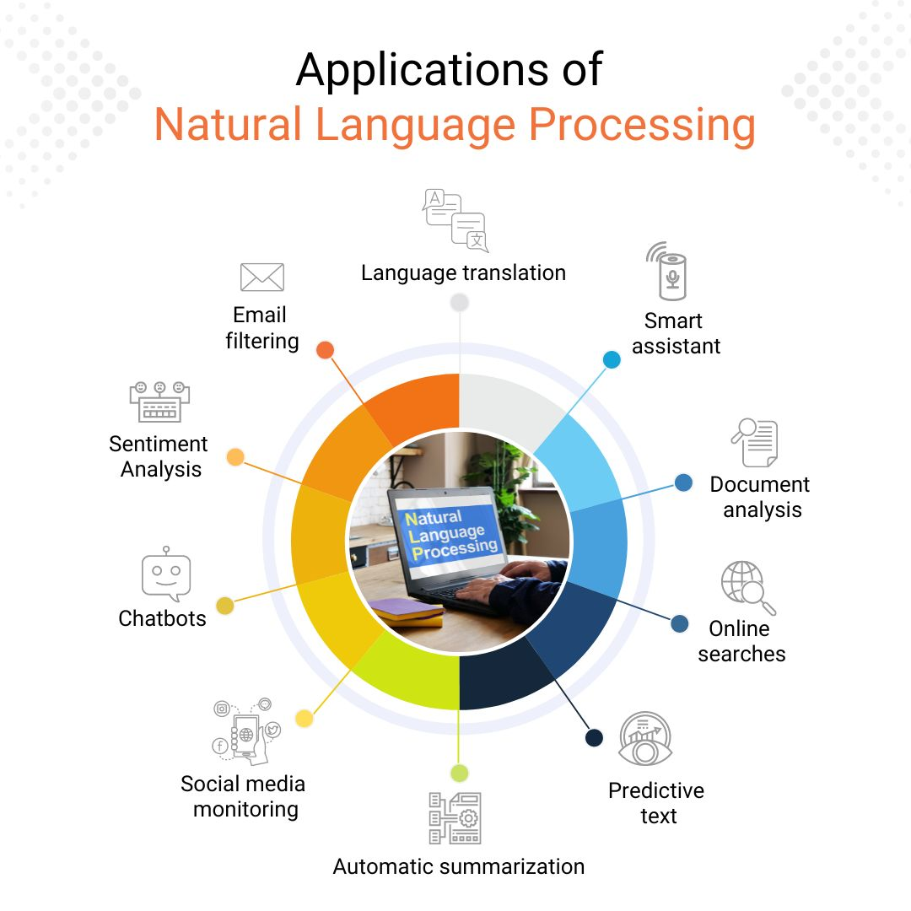

Slide 33
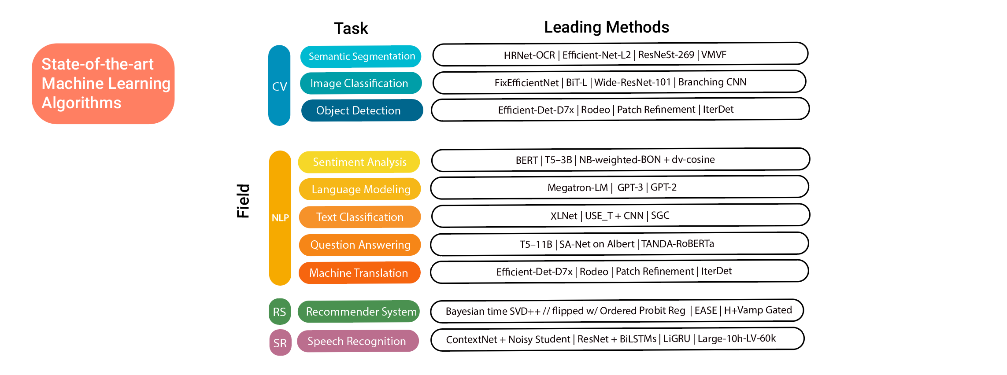

Slide 34
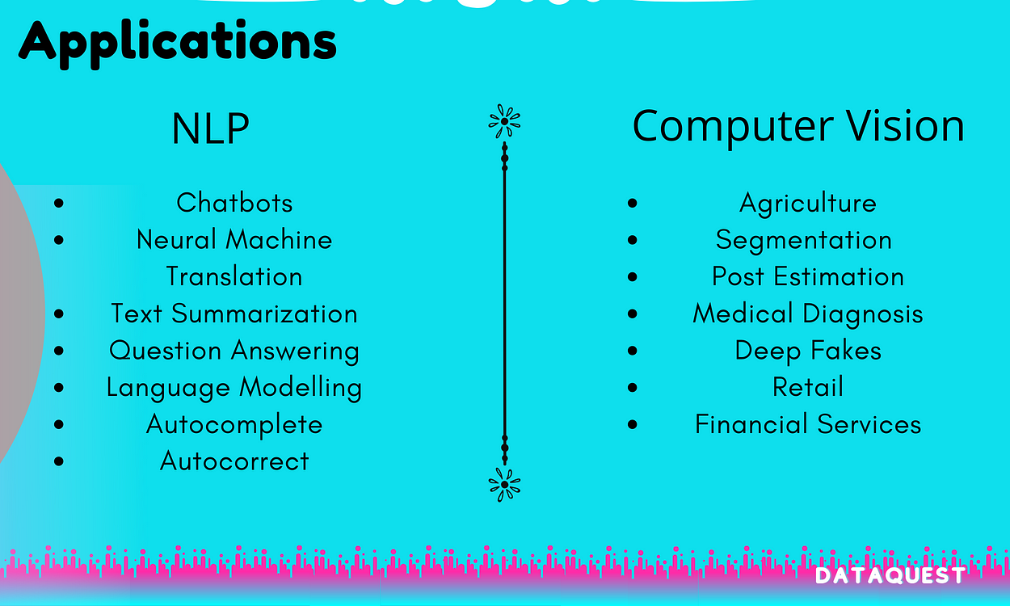

Slide 35

Questions

Slide 36
Thank you

